Slide 1
Super Scuba
Super Scuba offers the following:
Basic training
Advance training
Use of our training pool
Use of our equipment
Guided tours to diving locations

Slide 2
Equipment
To scuba dive you need this equipment:
Diving Mask
Flippers
Snorkel
Regulator and Breathing Tank
Wetsuit

Slide 3
Best Places to Dive
This chart shows the best places to dive:

Slide 4
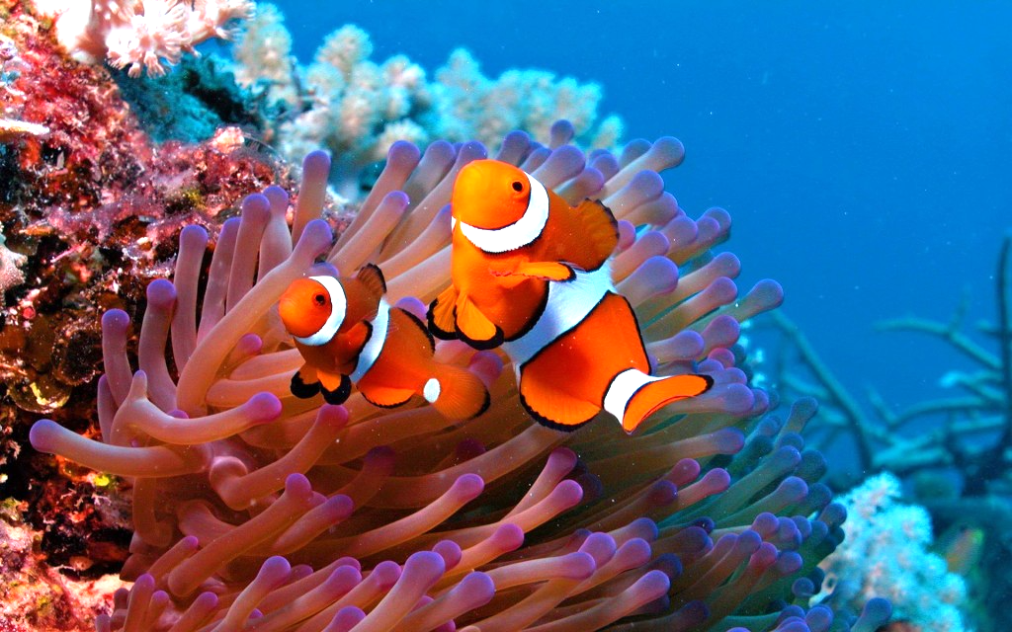
Fish you may see
Scorpion Fish
Clown Fish
Butterfly Fish
Parrot Fish
The beautiful clown fish

